Slide 1
Applications of Information and Communication Technologies
Rabail Asghar
Lecturer (Computer Science)
COMSATS University Islamabad, Lahore Campus

Slide 2
Topics to cover
Functions

Slide 3
Function
What is a Function?
A function is a group of statements that performs a specific operation. You can think of it as a mini-program within your main program that can be reused multiple times.

Slide 4
Basic Structure of a Function
def function_name(parameters):
# Code block
return value # Optional

Slide 5
Basic Structure of a Function
def: This keyword starts the function definition.
function_name: The name you choose for your function.
parameters: Variables that allow data to be passed into the function.
return: Optional keyword to return a result from the function.

Slide 6
Why Use Functions?
Reusability: Write the code once and reuse it.
Modularity: Break down complex programs into simpler parts.
Improved Readability: Functions organize code and make it more understandable.
Easy Debugging: Isolate and debug specific parts of code within functions.

Slide 7
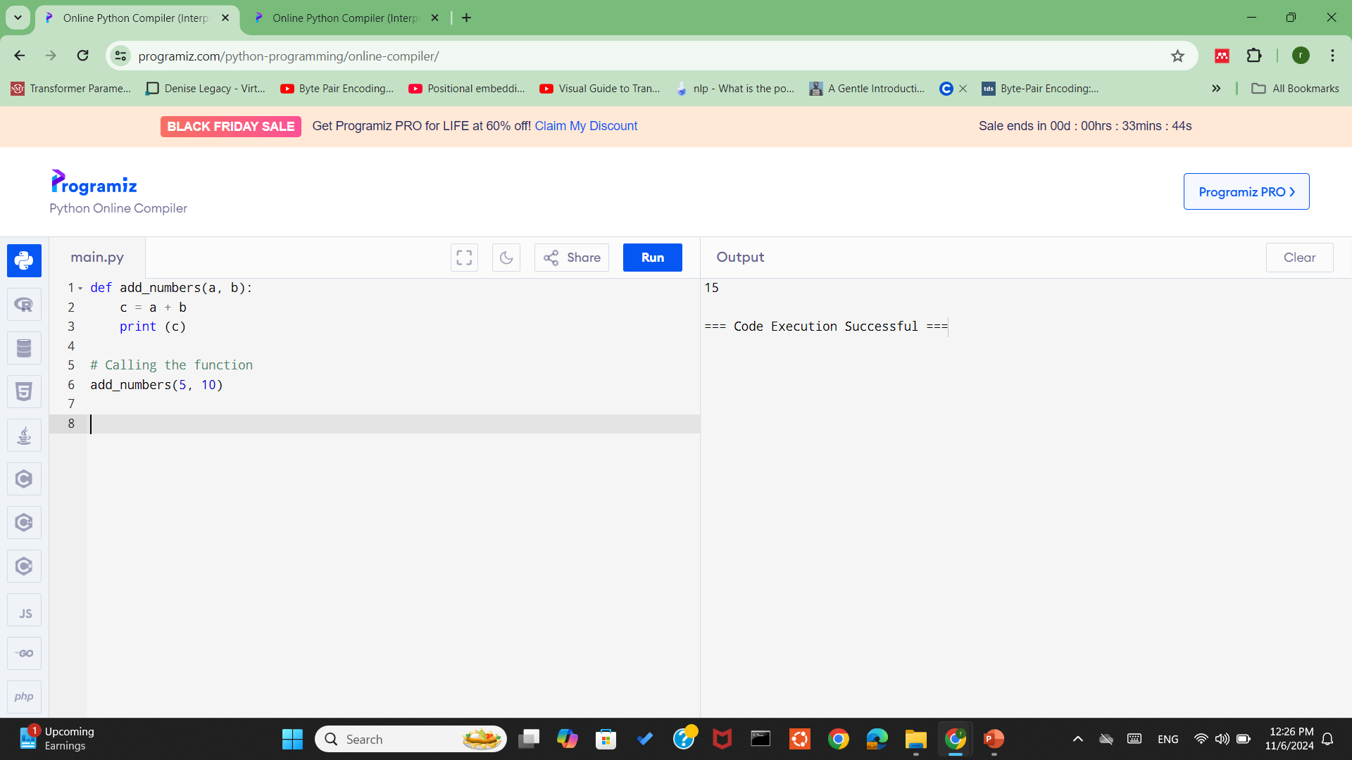
Example (without return)

Slide 8
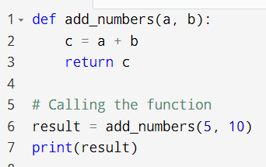
Example (with return)

Slide 9
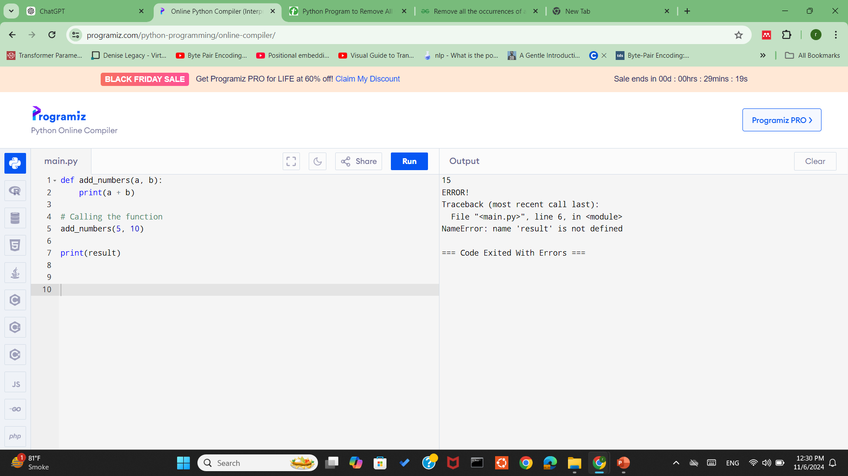
Return Values: Instead of printing within functions, return values so they can be used outside the function, in calculations or for some other purpose.

Slide 10

Practice1- Function to Calculate Total Sales

Slide 11
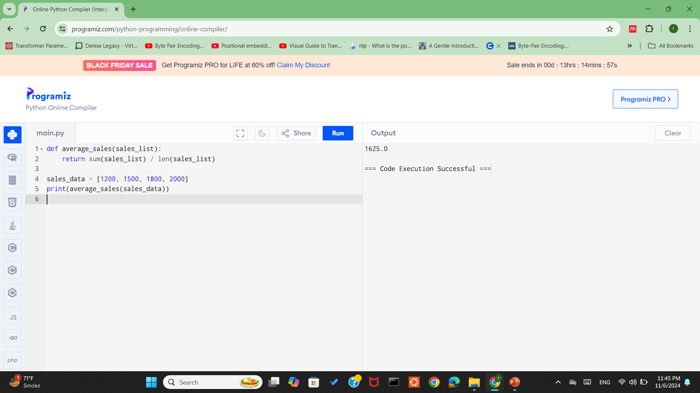
Practice2- Function to Calculate Average Sales

